Slide 1

Studbud: Your AI Personalized Study Planner
TEAM NAME: Null Pointers
TEAM MEMBERS:
M. Thanuja
M. Manisha
M. Sandhya
G. Pavithra
K. Shirisha

Slide 2
PROBLEM STATEMENT
Studbud : AI Personalized Study Planner" is an intelligent application designed to create customized student study plans based on their specific goals, strengths, weaknesses, and preferences. Utilizing the BERT (Bidirectional Encoder Representations from Transformers) architecture, this tool helps students optimize their study schedules to achieve their academic targets efficiently.
Traditional study plans often fail. They don't account for individual learning styles. Students waste time on ineffective strategies. Generic plans lack the adaptability needed for success.
The Problem: Generic Study Plans Don't Work

Slide 3

Proposed Solution:
Studbud creates personalized study schedules. Our AI adapts to your unique learning style. We help you achieve academic success efficiently.
Personalization
Create custom schedule for you.
Optimization
Continuously refining your study plan.

Slide 4



Audience Segment
Studbud utilizes a three-step process. First, users input their data. Then, our AI analyzes it. Finally, Studbud optimizes the study schedule. This ensures maximum efficiency.
2
Collaboration
Tutors and Educators, Online Learning
influencers
.
Online platform
1
Like Coursera, Udemy
Marketing
3
Study Tips Blog, Video Tutorials

Slide 5
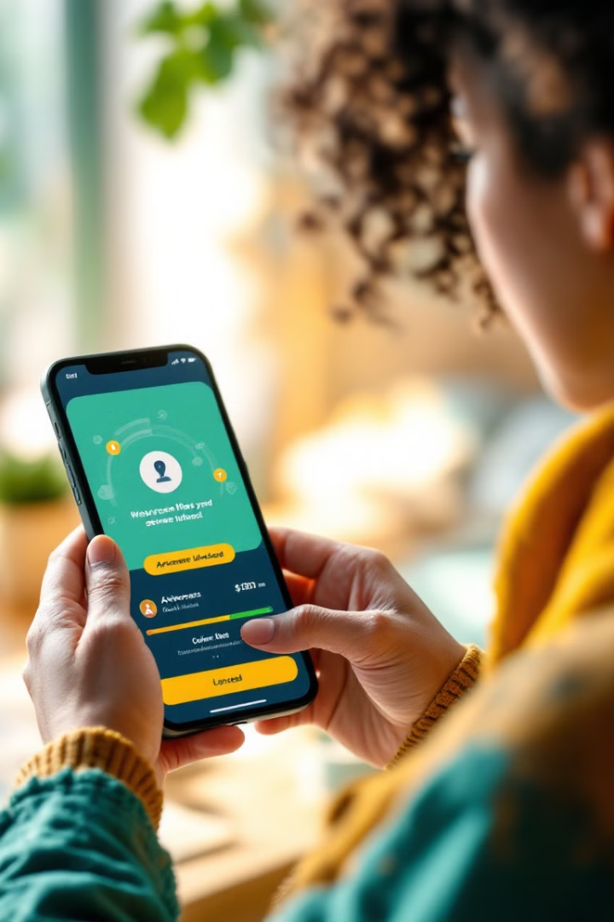
Key Features: Adaptive Learning, Goal Setting
Studbud offers adaptive learning. You can set goals and track your progress. Our features enhance your study experience. We ensure continuous improvement.
Adaptive Learning
Goal Setting
Adjusts to your pace and comprehension.
Define clear, achievable objectives.

Slide 6




Market Opportunity & Future Development
The market for personalized learning is growing. Studbud is positioned to capture a large share. We plan to add new features and expand partnerships. We aim for global reach.
1
Global Expansion
2
Partnerships
3
New Features
4
Growing Market

Slide 7
Thank You

